Slide 1


Data Analysis on Social Buzz

Slide 2


Today's agenda
Project recap
Problem
The Analytics team
Process
Insights
Summary

Slide 3

cs
Social Buzz headquartered at San Francisco is a Social media & content creation company that has scaled quickly in last few years and anticipated and needs the help of an advisory firm to oversee their data scaling process effectively.
Due to their rapid growth and digital nature of their core product, the amount of data that they create, collect and must analyze is huge. Every day over 100,000 pieces of content, ranging from text, images, videos and GIFs are posted.
All this data is highly unstructured and requires extremely sophisticated and expensive technology to manage and maintain. Out of the 250 people working at Social Buzz, 200 of them are technical staff working on maintaining this highly complex technology.
Project Recap

Slide 4


Problem
Everyday with 100,000 pieces of data content in unstructured manner, Social Buzz is looking for
1. IPO(Initial Public Offering) by the end of next year and need guidance to ensure that this goes smoothly.
2. They want an experienced practice to help on data scaling process.
3. They want to learn data best practices on understanding how the world's biggest companies manage the challenges of big data.

Slide 5

The Analytics team
Arnav (Data Analyst)

Slide 6
Process
1
Data Understanding
2
Data Preprocessing
Data Cleaning
3
4
Data Transformation and Modeling
5
Analysis and Insights

Slide 7
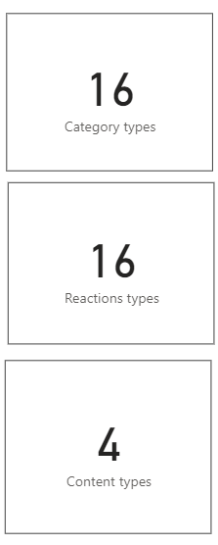
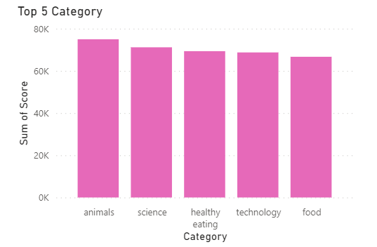
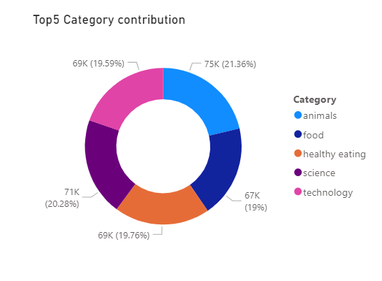

Insights

Slide 8
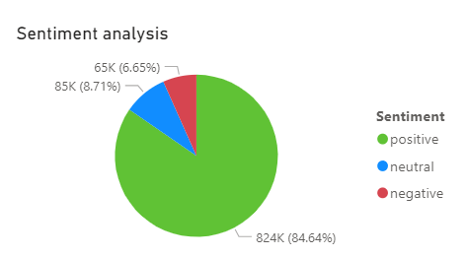
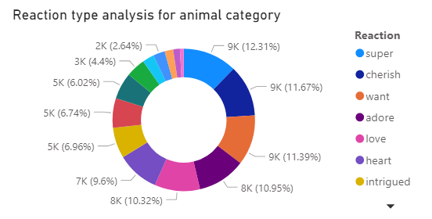
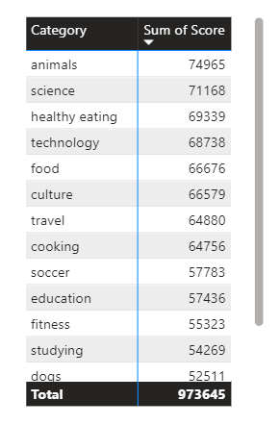
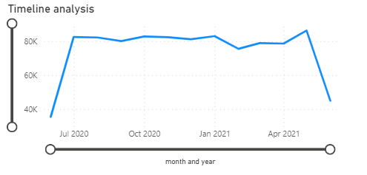

Slide 9
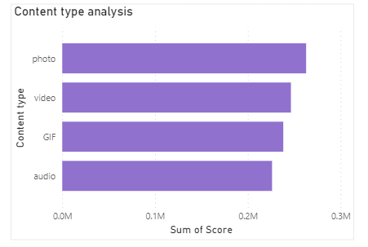
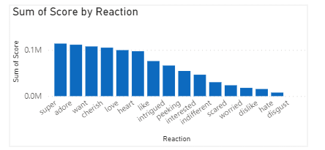
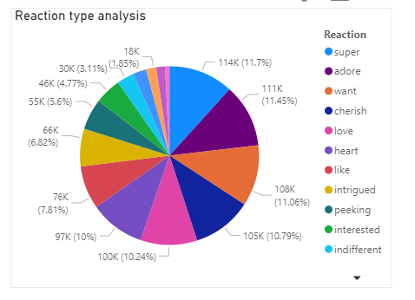

Slide 10

Insights
Animals, Science, Healthy eating, Technology and Food were the top 5 categories that were shared in Social Buzz
Based on content type analysis, photos were most shared data in Social Buzz followed by video contents
People tend to react to the contents in the most positive manner which gives around 84.64% in overall contribution
Most of the posts/reactions were shared around May 2021
Super was the popular reaction shared by most people followed by adore, want and cherish
Similarly, people reacted with Super the most for Animal content sharing
Next Step
People tend to be interested in sharing eating and technology related contents along with Animals post. So Social Buzz can promote their company using these contents.
Encourage people to share more science/tech and healthy eating/food contents
Providing more filters for photos and videos can encourage people to use Social Buzz
We can investigate on the recent trend analysis based on categories.
Summary

Slide 11


Thank you!
ANY QUESTIONS?

